Slide 1
ENEL 895AK
Hierarchical Self-Certified Key Management

Slide 2
Hierarchical Self-Certified Management
[2] proposes a cluster-based system for establishing secure sessions between cluster heads and members with no prior shared knowledge
This system was proposed for medical sensor network applications
This system depends on a tree-based hierarchy system and is based on setting up Shared Session Keys (SSK) between cluster heads and members
The system has a root level Secure Access Point (SAP) which acts as the WSN gateway. The root SAP manages other cluster head SAP’s in the backbone cluster. These cluster head SAP’s in turn manage nodes in their cluster.
C. H. Tseng, S. Wang and W. Tsaur, "Hierarchical and Dynamic Elliptic Curve Cryptosystem Based Self-Certified Public Key Scheme for Medical Data Protection," in IEEE Transactions on Reliability, vol. 64, no. 3, pp. 1078-1085, Sept. 2015.

Slide 3
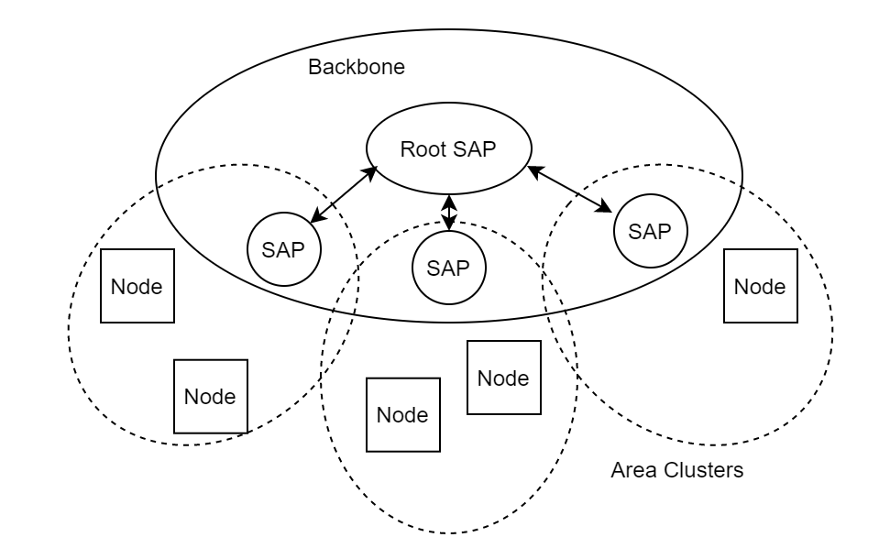
Architecture of the System
The Root SAP manages all cluster heads in the Backbone Cluster
Each cluster head SAP is responsible for an area cluster
The SAP’s drive session creation and management
Each SAP has a pre-established SSK with the Root
Each Node dynamically creates a new SSK with their SAP when needed

Slide 4
Setup and Registration Phase
Network setup consists of nodes registering with a cluster head (CH) to become cluster members (CM)
The registration phase is used to let the CH know about the new CM and to derive a public/private key pair for the CM to use
The key pair is built using the CM’s master key and the CH’s private key
This process allows the CH to derive the public key of the CM
It also allows the CM to derive the private key without the CH having access to it
The CH manages sessions for its cluster, and the CMs send data through the CH inside these sessions

Slide 5
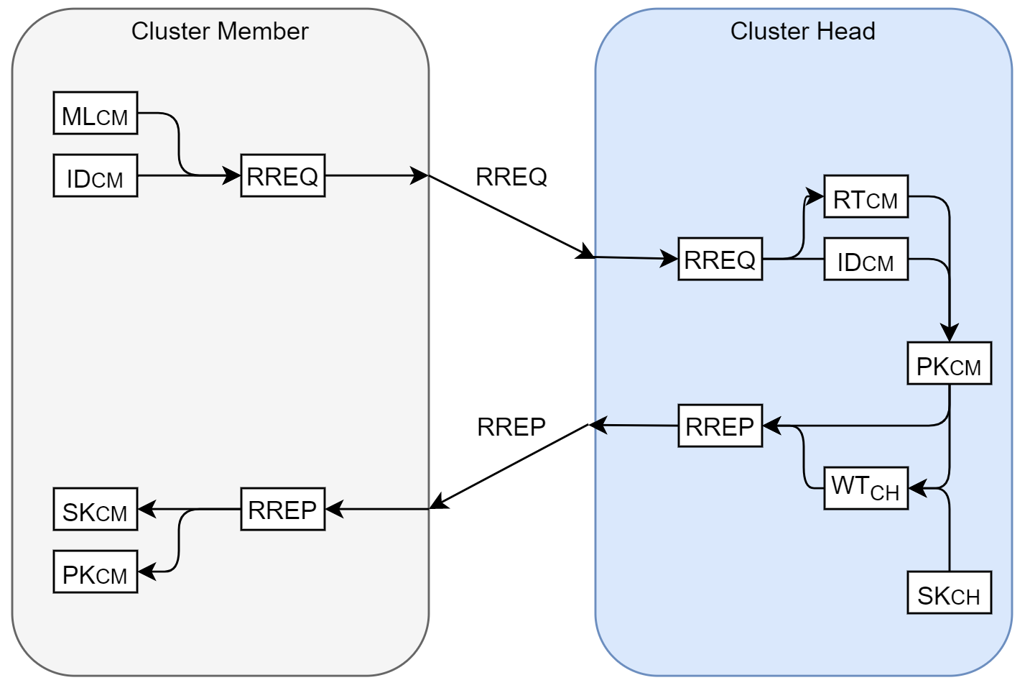
Node Registration
ML - Master Key
ID - Node ID
RT - Registration Token
WT - Witness Token
PK - Public Key
SK - Private Key
RREQ - Registration Request
RREP - Registration Response

Slide 6
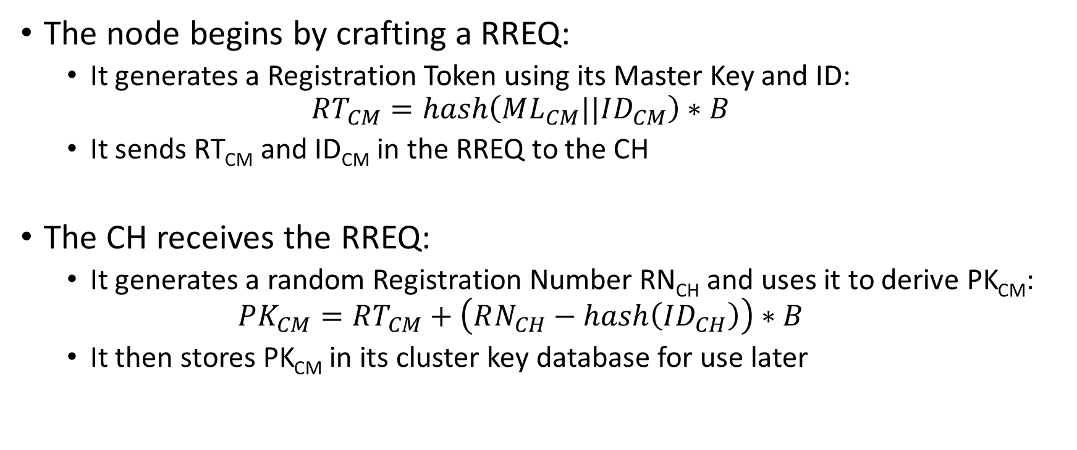
Deriving Key Pairs
The node begins by crafting a RREQ:
It generates a Registration Token using its Master Key and ID:
$$RT_{CM}=hash\left(ML_{CM}||ID_{CM}\right)∗B$$
It sends RT_{CM} and ID_{CM} in the RREQ to the CH
The CH receives the RREQ:
It generates a random Registration Number RN_{CH} and uses it to derive PK_{CM}:
$$PK_{CM}=RT_{CM}+\left(RN_{CH}−hash\left(ID_{CH}\right)\right)∗B$$
It then stores PK_{CM} in its cluster key database for use later

Slide 7
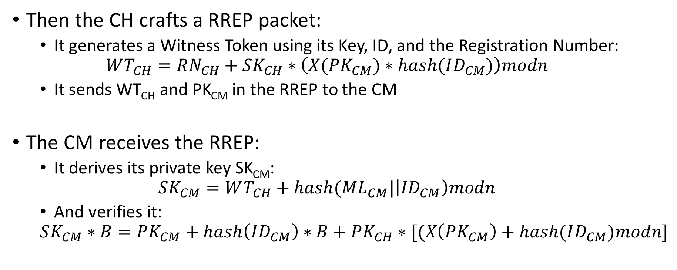
Deriving Key Pairs
Then the CH crafts a RREP packet:
It generates a Witness Token using its Key, ID, and the Registration Number:
$$WT_{CH}=RN_{CH}+SK_{CH}∗\left(X(PK_{CM})∗hash(ID_{CM})\right)modn$$
It sends WT_{CH} and PK_{CM} in the RREP to the CM
The CM receives the RREP:
It derives its private key SK_{CM}:
$$SK_{CM}=WT_{CH}+hash(ML_{CM}|\left|ID_{CM}\right)modn$$
And verifies it:
$$SK_{CM}∗B=PK_{CM}+hash\left(ID_{CM}\right)∗B+PK_{CH}∗[(X\left(PK_{CM}\right)+hash(ID_{CM})modn]$$

Slide 8
Communication Phase
A communication is initiated by the CM by sending a SREQ packet
The first step in communication is the CM and CH setting up a Shared Session Key (SSK), which is a one-time shared secret:
The SSK is derived using the previously established public/private key pair
The SSK can be derived without the CM having to send or store its own public key
This helps reduce data transmitted by the CM which is a lower function node
This way, the CM only needs to share it’s ID and a Time Token with the CH, then use the returned Session Token and its private key to derive the SSK

Slide 9
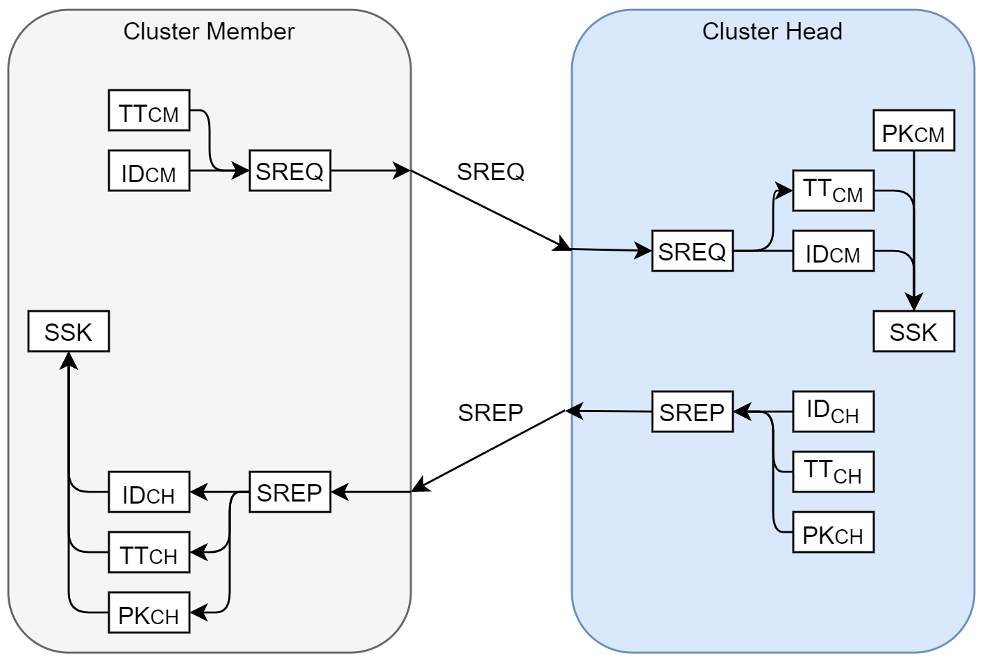
Shared Session Key
TT - Time Token
ID - Node ID
PK - Public Key
SSK - Shared Session Key
SREQ - Session Request
SREP - Session Response

Slide 10
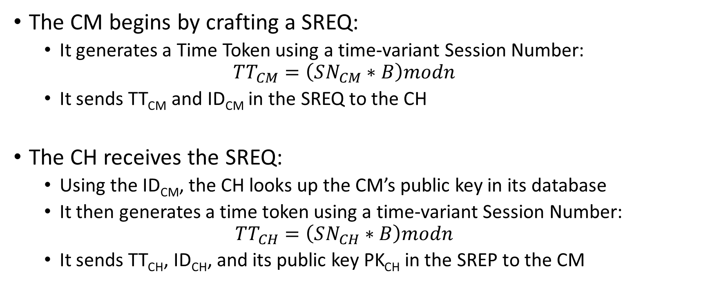
Deriving Shared Session Key
The CM begins by crafting a SREQ:
It generates a Time Token using a time-variant Session Number:
$$TT_{CM}=\left(SN_{CM}∗B\right)modn$$
It sends TT_{CM} and ID_{CM} in the SREQ to the CH
The CH receives the SREQ:
Using the ID_{CM}, the CH looks up the CM’s public key in its database
It then generates a time token using a time-variant Session Number:
$$TT_{CH}=\left(SN_{CH}∗B\right)modn$$
It sends TT_{CH}, ID_{CH}, and its public key PK_{CH} in the SREP to the CM

Slide 11
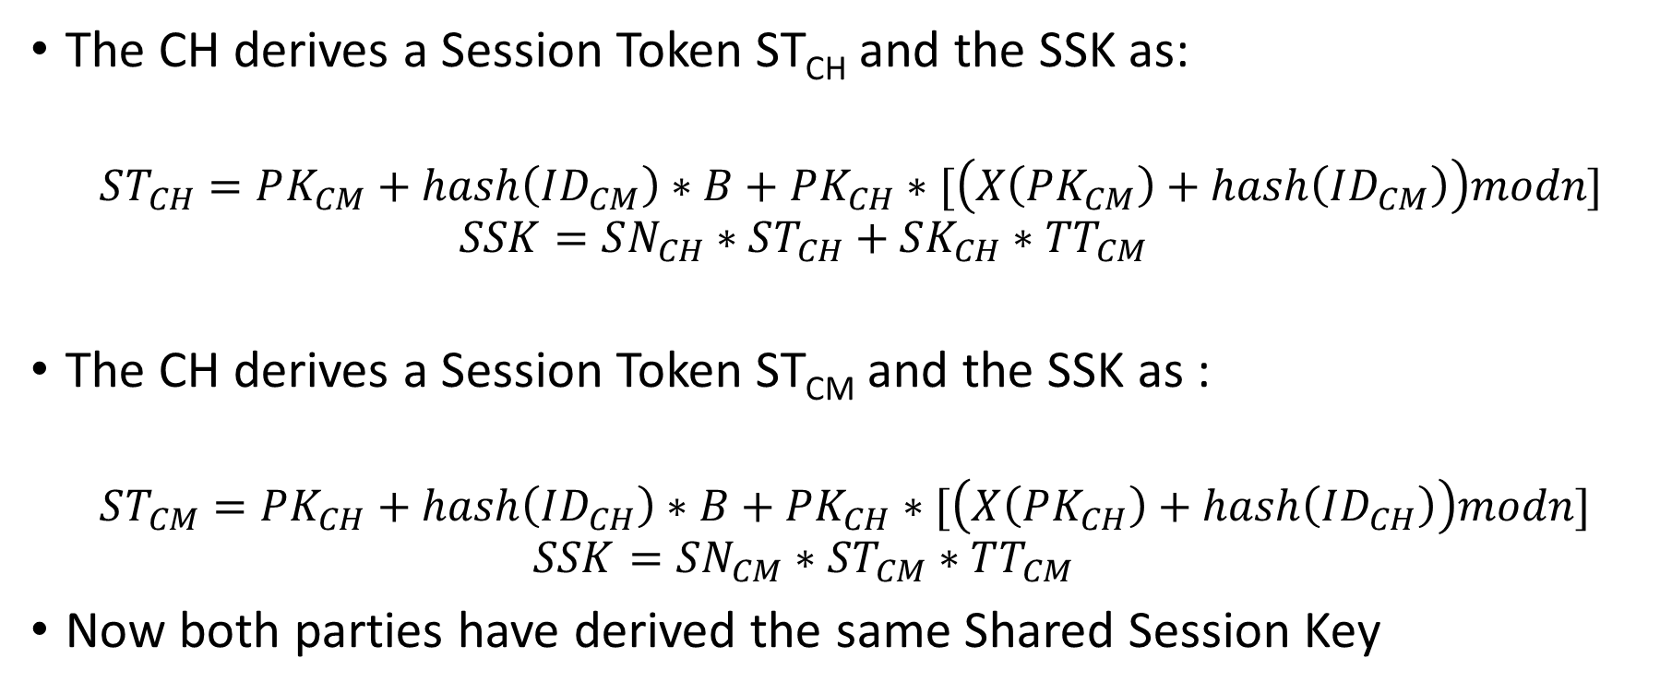
Deriving Shared Session Key
The CH derives a Session Token ST_{CH} and the SSK as:
$$ST_{CH}=PK_{CM}+hash\left(ID_{CM}\right)∗B+PK_{CH}∗[\left(X\left(PK_{CM}\right)+hash\left(ID_{CM}\right)\right)modn]$$
$$SSK=SN_{CH}∗ST_{CH}+SK_{CH}∗TT_{CM}$$
The CH derives a Session Token ST_{CM} and the SSK as :
$$ST_{CM}=PK_{CH}+hash\left(ID_{CH}\right)∗B+PK_{CH}∗[\left(X\left(PK_{CH}\right)+hash\left(ID_{CH}\right)\right)modn]$$
$$SSK=SN_{CM}∗ST_{CM}∗TT_{CM}$$
Now both parties have derived the same Shared Session Key

Slide 12
Testing
The protocol was implemented on the following testbed:
The Root SAP was a CPU connected to a cloud server using Ethernet and connected to a Zigbee network using a USB dongle
The SAP’s were Beaglebone boards running a Linux container with a USB dongle used to access the Zigbee network
The cluster members were Beaglebone boards running a Linux container, with an SD card interface used for storage and a USB dongle used to access the Zigbee network
The testbed used an ECG dataset stored on the SD cards on each node to simulate real medical data in the network

Slide 13
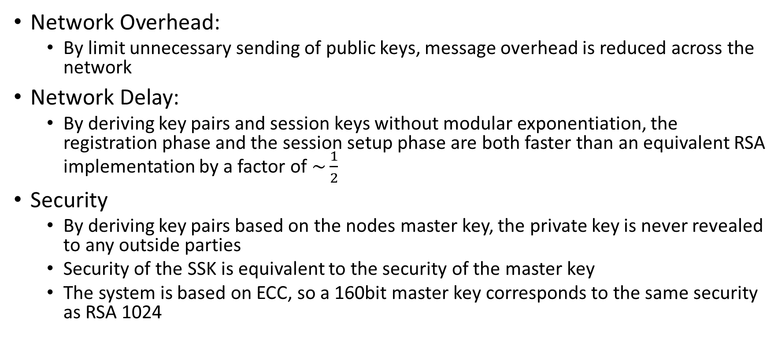
Results – Network Performance
Network Overhead:
By limit unnecessary sending of public keys, message overhead is reduced across the network
Network Delay:
By deriving key pairs and session keys without modular exponentiation, the registration phase and the session setup phase are both faster than an equivalent RSA implementation by a factor of $\sim \frac{1}{2}$
Security
By deriving key pairs based on the nodes master key, the private key is never revealed to any outside parties
Security of the SSK is equivalent to the security of the master key
The system is based on ECC, so a 160bit master key corresponds to the same security as RSA 1024

Slide 14
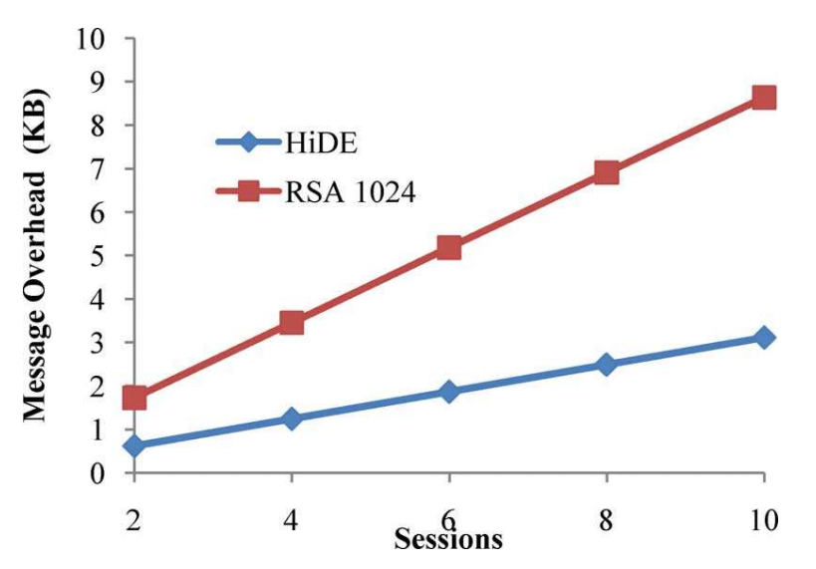
Results – Cluster Member
The results show significantly less overhead than a comparable RSA 1024 protocol
As the number of parallel sessions in the network increases, the overhead savings increase
Message overhead in an area cluster

Slide 15
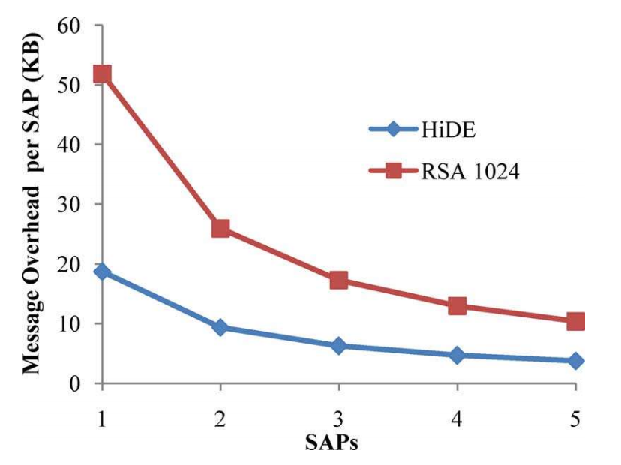
Results – Cluster Head
As can be expected, the message overhead per Cluster head decreases as clusters are added
The change in savings per SAP decreases as more SAP’s are added
This is due to smaller area clusters being formed
This tends to zero as the number of SAP’s approaches the number of nodes
Message overhead per Cluster Head based on 60 Nodes

Slide 16
References
C. H. Tseng, S. Wang and W. Tsaur, "Hierarchical and Dynamic Elliptic Curve Cryptosystem Based Self-Certified Public Key Scheme for Medical Data Protection," in IEEE Transactions on Reliability, vol. 64, no. 3, pp. 1078-1085, Sept. 2015.

